Slide 1
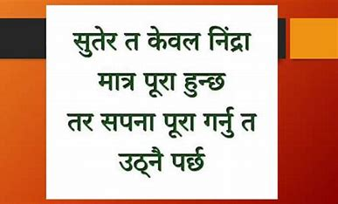

Slide 2


Slide 3
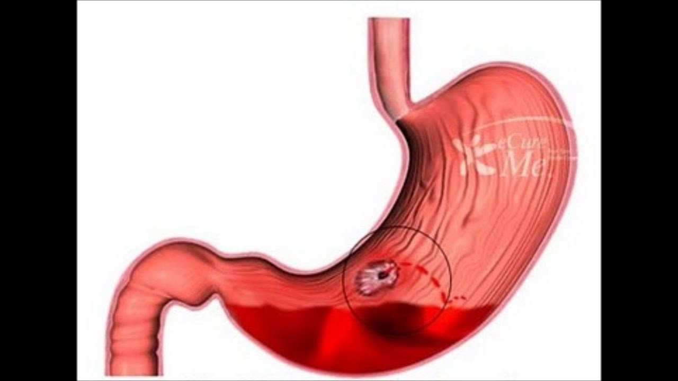
GASTROINTESTINAL BLEEDING
Prepared by:
Bandana Tiwari
Roll no: 6
BNS 2nd year
17th batch

Slide 4

GASTROINTESTINAL BLEEDING

Slide 5
INTRODUCTION
Gastrointestinal bleeding refers to the hemorrhage in the upper and the lower gastrointestinal tract.
Upper GI bleed (pharynx to ligament of treitz ) and lower GI bleed (ligament of treitz to rectum).

Slide 6
Cont..
GI bleeds are considered medical emergencies and requires admission to hospital for urgent diagnosis and management.
Epidemiology : Upper V/S lower GI bleeding = 5:1

Slide 7
CAUSES
Peptic ulcer disease :
Oesophageal varices
Mallory –Weiss syndrome
Reflux esophagitis

Slide 8
Cont..
Erosive gastritis:
Gastric carcinoma
Aorto enteric fistula
Angiodysplasia

Slide 9
Cont..
Lower GI bleeding
Diverticulosis
Hemorrhoids
Infectious diarrhea

Slide 10
SIGNS AND SYMPTOMS
Hematemesis
Melena
Hematochezia
Symptoms of anemia
Occult positive

Slide 11
Cont..
6. Collapse and shock
7. Other associated symptoms :
Heartburn
Postural hypotension
Fatigue
Diffuse abdominal pain

Slide 12
DIAGNOSTIC INVESTIGATION
History taking
Physical examination
Blood test
Colonoscopy
Abdominal USG or CT
Angiography

Slide 13
TREATMENT
MEDICAL MANAGEMENT
Treat the cause of bleeding
H2 receptor antagonist- cimetidine , ranitidine
Proton pump inhibitors- omeprazole, lansoprazole
H. pylori eradication

Slide 14
Cont..
Triple regimen- 1st line therapy PPI( omeprazole , lansoprazole, pantoprazole ) +2 of these 3 antibiotics ( clarithromycin , amoxicillin, metronidazole)
2nd line therapy : PPI, bismuth , metronizadole, tetracycline for 7 days.
Vasoconstrictors (octreoide) to reduce bleeding
Corticosteroid
Probiotics

Slide 15
SURGICAL MANAGEMENT
Gastrectomy
Band ligation
Vagotomy

Slide 16
NURSING MANAGEMENT
Access the patient general condition (including circulatory status, seek evidence of liver disease ).
The first step is to gain intravenous access using at least one large – bore cannula .
Resuscitation:
Intravenous crystalloid fluids or colloid are given to restore the blood pressure.

Slide 17
Cont..
Blood is transfused when the patient is shocked or when the hemoglobin concentration is less than 100g per liter.
Normal saline should be avoided in patient with liver disease because it can cause ascities.
4. Oxygen should be given by facemask to all patient in shock.
5. Patient should be closely observed , with hourly pulse, blood pressure and urine output measurements.

Slide 18
Cont..
6. Endoscopic therapy may stop active bleeding and combined with intravenous PPI therapy, prevent bleeding , thus avoiding the need for surgery.
7. Monitor for lab investigation.
8. When endoscopic haemostasis fails to stop active bleeding urgent surgical operation is indicated.
9. Provide knowledge about disease condition.
10. Provide psychological support.

Slide 19
COMPLICATION
ENDOSCOPY
Aspiration pneumonia
Perforation
Complication from coagulation
SURGERY
Ileus
sepsis

Slide 20
PREVENTION
Avoid alcohol and smoking that increases gastric secretion.
Eat high – fiber diet to increase bulk of stool which helps prevent diverticulosis and hemorrhoids.

Slide 21
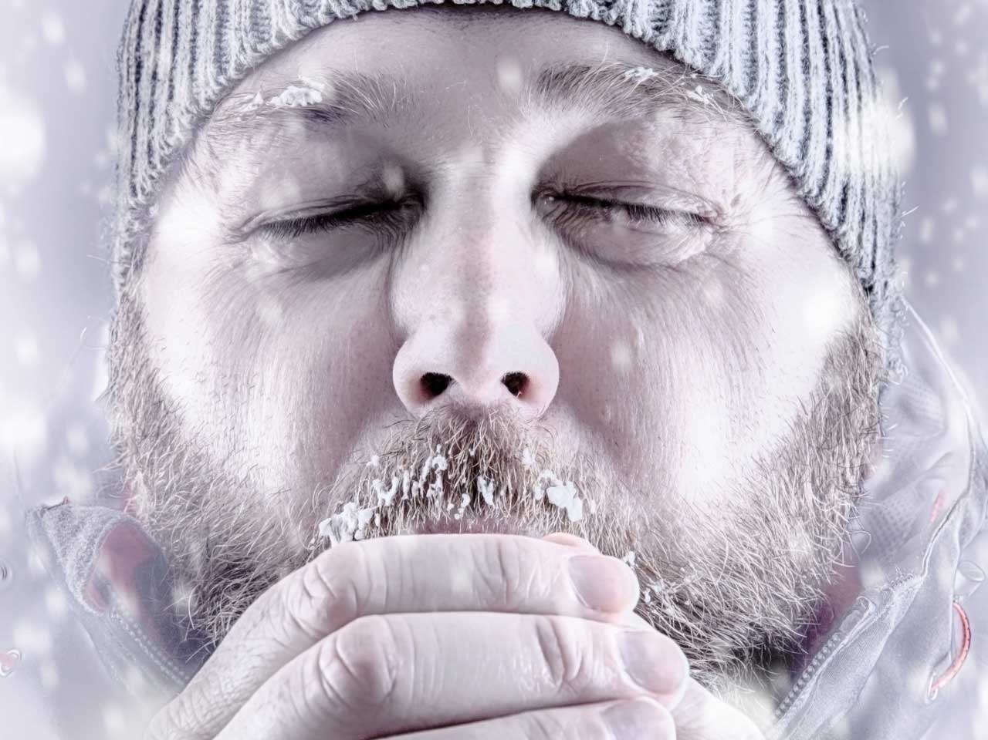
HYPOTHERMIA

Slide 22

HYPOTHERMIA

Slide 23
INTRODUCTION
Hypothermia is potentially dangerous drop in body temperature, usually caused by prolonged exposure to cold temperature.
With hypothermia , core temperature drops below 95 degrees.
In severe hypothermia , core body temperature can drop to 82 degree or lower.

Slide 24
TYPES
PRIMARY HYPOTHERMIA
SECONDARY HYPOTHERMIA
INTENTIONAL HYPOTHERMIA

Slide 25
RISK FACTORS
Increased heat loss
Decrease heat production
Coagulation disorder
Renal failure
Drug induced impairment

Slide 26
SIGNS AND SYMPTOMS
Shivering
Slow, shallow breathing
Confusion and memory loss
Drowsiness

Slide 27
Cont..
5. Slurred speech
6. Loss of coordination
7. A slow , weak pulse
8. In severe hypothermia , a person may be unconscious

Slide 28
TREATMENT
Blood rewarming
Warm intravenous fluids
Airway rewarming
Irrigation

Slide 29
NURSING MANAGEMENT
Access the patient general condition.
Maintain the room temperature at 65 degrees fahrenheit at a minimum; some very frail older adults will requires higher room temperature to maintain body warmth and comfort.
Wear appropriate clothes; keep blankets around for people with sever arthritis, paralysis from stroke, cognitive impairment or injury who find it harder to move around or dress to stay warm.

Slide 30
Cont..
4. Limit the time that the older adults is exposed to a cold area.
5.Minimize heat loss from the head by providing a hat or scarf to cover the head and neck when possible, particularly when the older adults is outside.
5. Whenever it is necessary to remove all the person’s clothing , minimize the exposure time.

Slide 31
Cont..
6. Dry wet hair quickly with an electric hair dryer: do not let wet hair air dry.
7. If the person has incontinence of urine , use absorbent pads, and check often for wet clothing or bedding.
8. Encourage exercise to help the person generate heat from muscle activity.

Slide 32
Cont..
9. Provide hot, high protein meals and bedtime snacks to sustain heat production during the day and evening.
10. Do not drink alcohol before falling asleep when it is colder , sometimes alcohol can loss body heat faster.
11. Manage illness that make it harder to stay warm like hormone disorders, diabetes, and some skin problems.
12. Know about medications that can affect body temperature .

Slide 33
COMPLICATION
Arrhythmias
Pneumonia
Pancreatitis
Acute renal failure
Intravenous coagulation

Slide 34


Slide 35


Slide 36
ASSIGNMENT
What do you understand about hypothermia ? Write its nursing management .
2) Write short note on:
Gastrointestinal bleeding

Slide 37
PLAN FOR NEXT CLASS
We will discuss about National and social support system available to elderly.

Slide 38
REFERENCES
K.C, T, & Rai, B, (2019). A Textbook of Geriatric Nursing. (3rd ed). Heritage publisher and distributors.
Subbha.K,H & Subedi, P,S,(2019). A Textbook of Geriatric Nursing. (1st ed). National book centre.
Baral.R, Essential of Geriatric Nursing. Makalu publication.
Pradhan.M,K & Roka, A,T.(2015). Gerontological Nursing for BN/BSN Students. (1st ed) Vidyarthi publication.
Timalsina,R, (2020). Comprehensive Textbook of geriatric Nursing (3rd ed). Samiksha publication.

Slide 39


